Slide 1

Computer Vision Image Segmentation
School of Software, SJTU

Slide 2
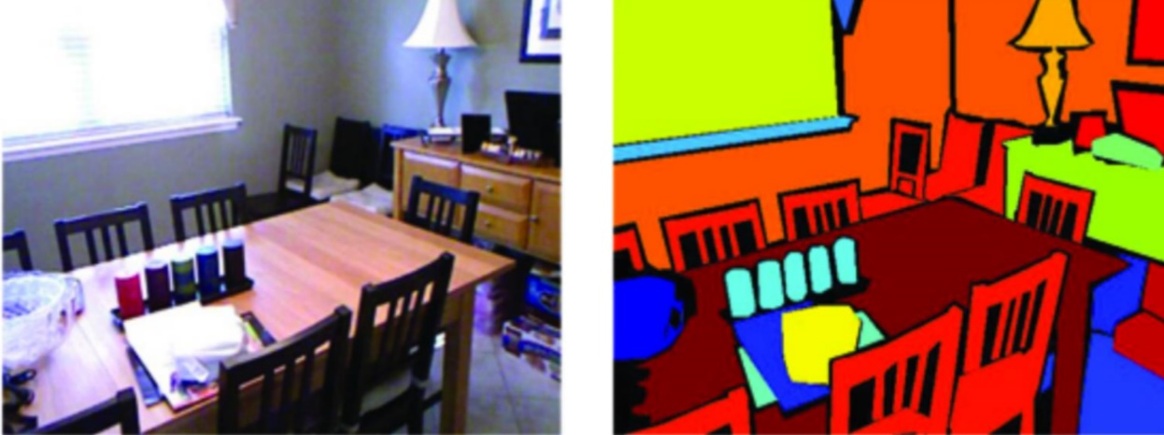
Image Segmentation
One way to represent an image using a set of components
Components share common properties
Properties can be defined at different levels of abstraction
From: Chris Choy, Ph.D. candidate Stanford Vision and Learning Lab (SVL)

Slide 3
From Images to Objects
What defines an object?
Subjective problem, but has been well studied.
Gestalt laws seek to formalize this.
“What is interesting and what is not” depends on the application.
Broad theory is absent at present.

Slide 4
Gestalt Laws
A series of factors affect whether elements should be grouped together.
Proximity: tokens that are nearby tend to be grouped.
Similarity: similar tokens tend to be grouped together.
Common fate: tokens that have coherent motion tend to be grouped together.
Common region: tokens that lie inside the same closed region tend to be grouped together.
Parallelism: parallel curves or tokens tend to be grouped together.
Closure: tokens or curves that tend to lead to closed curves tend to be grouped together.
Symmetry: curves that lead to symmetric groups are grouped together.
Continuity: tokens that lead to “continuous” curves tend to be grouped.
Familiar configuration: tokens that, when grouped, lead to a familiar object, tend to be grouped together.

Slide 5
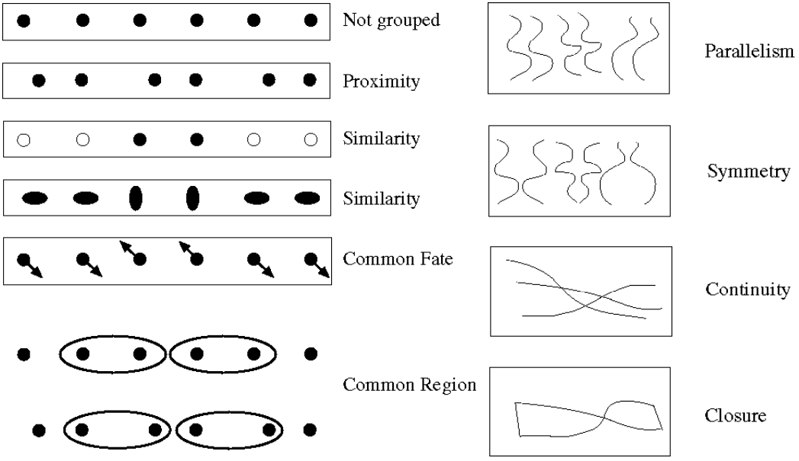
Gestalt Laws

Slide 6
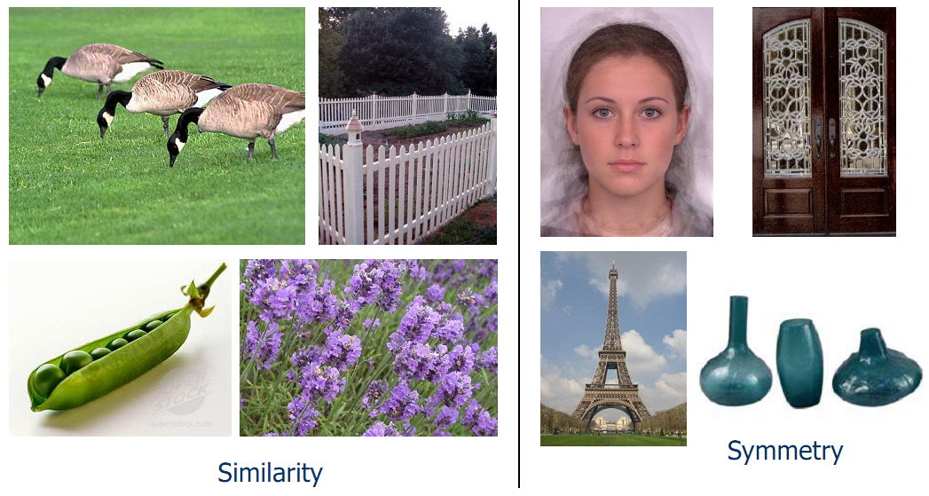
Gestalt Laws

Slide 7
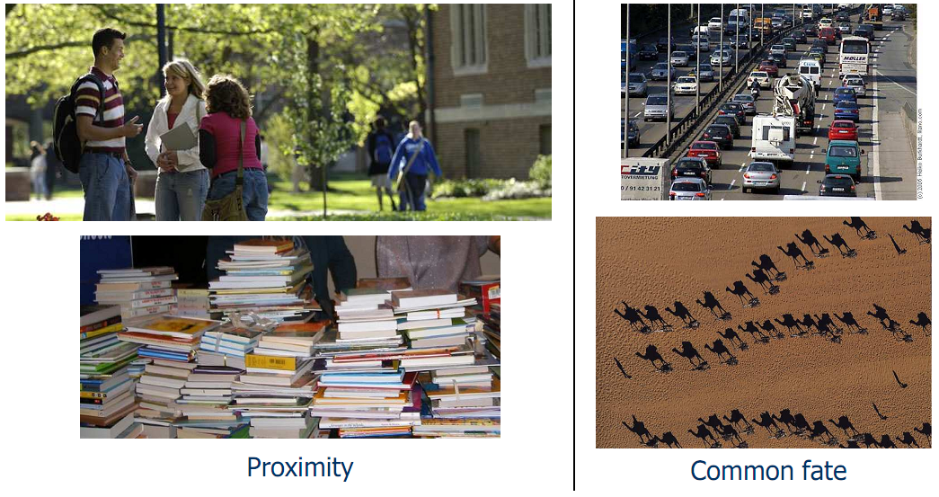
Gestalt Laws

Slide 8
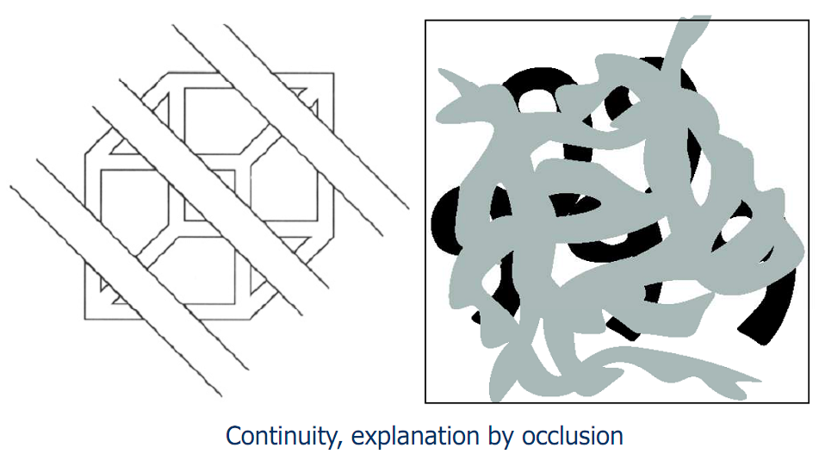
Gestalt Laws

Slide 9
Image Segmentation
Image segmentation is the operation of partitioning an image into a collection of connected sets of pixels.
Segmentation criteria: a segmentation is a partition of an image I into a set of regions S satisfying:
∪ S_{i}= S Partition covers the whole image.
S_{i}∩ S_{j}= ∅, i ≠ j No regions intersect.
∀ S_{i}, P(S_{i}) = true Homogeneity predicate is satisfied by each region.
P(S_{i}∪ S_{j}) = false, Union of adjacent regions i ≠ j, S_{i} adjacent S_{j} does not satisfy it.

Slide 10
Image Segmentation
So, all we have to do is to define and implement the similarity predicate.
Is there any property that will cause the regions to be meaningful objects?
Example approaches:
Histogram-based
Clustering-based
Region growing
Split-and-merge
Morphological
Graph-based

Slide 11
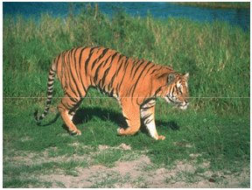
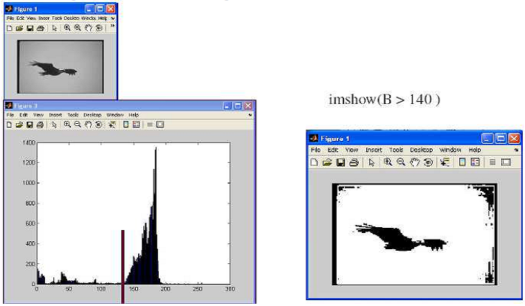
Histogram-based Segmentation
How many “orange” pixels are in this image?
This question can be answered by looking at the histogram.

Slide 12
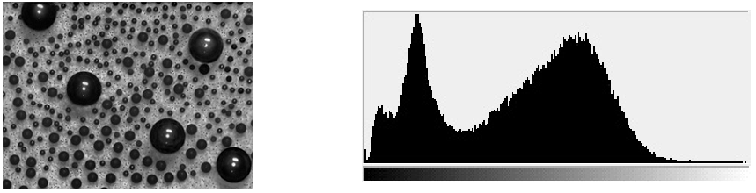
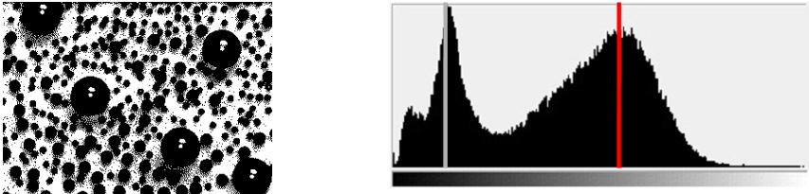
Histogram-based Segmentation
How many modes are there?
Solve this by reducing the number of colors to K and mapping each pixel to the closest color.
Here’s what it looks like if we use two colors.

Slide 13
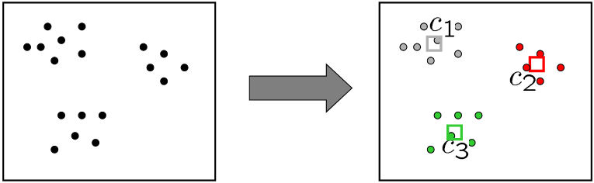
Clustering-based Segmentation
How to choose the representative colors?
This is a clustering problem.
K-means algorithm can be used for clustering.
http://home.dei.polimi.it/matteucc/Clustering/tutorial_html/AppletKM.html
http://www.math.le.ac.uk/people/ag153/homepage/KmeansKmedoids/Kmeans_Kmedoids.html
Non-parametric Bayesian
Energy-based methods …

Slide 14
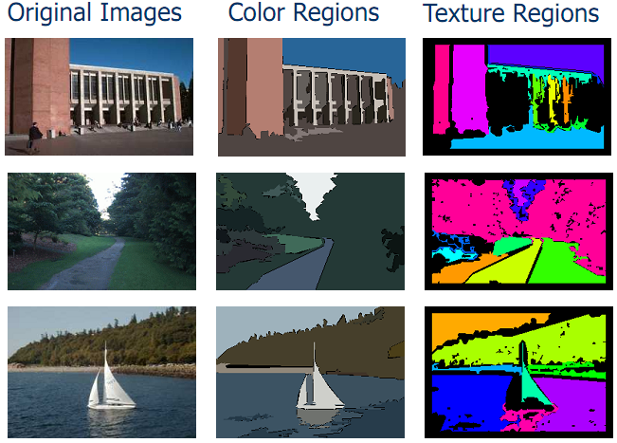
Clustering-based Segmentation
Clustering can also be used with other features (e.g., texture) in addition to color.

Slide 15

K-means Clustering
$$E\left(x,S\right)=\sum_{i}^{K}{\sum_{x∈S_{i}}{\left\|\left(x−μ_{i}\right.)\right\|}}$$
Minimize the sum of distance to the centroid for all clusters
NP-hard (Dasgupta et al. The hardness of k-means clustering)
Heuristic algorithm
Random initialization
Repeat:
Assignment: find the cluster ID for all point
Update centroids

Slide 16
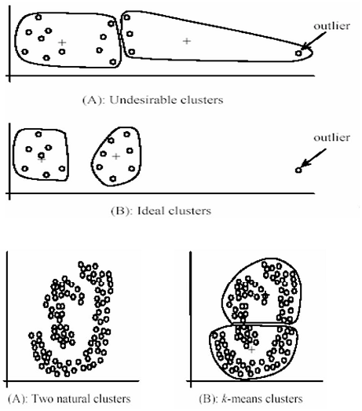
Clustering-based Segmentation
Pros:
Simple, fast to compute
Converges to local minimum of within-cluster squared error
Cons:
Setting K?
Sensitive to initial centers
Sensitive to outliers
Detects spherical clusters

Slide 17
Clustering-based Segmentation
K-means variants:
Different ways to initialize the means.
Different stopping criteria.
Dynamic methods for determining the right number of clusters (K) for a given image.
Problem: histogram-based and clustering-based segmentation using color/texture/etc can produce messy/noisy regions.

Slide 18
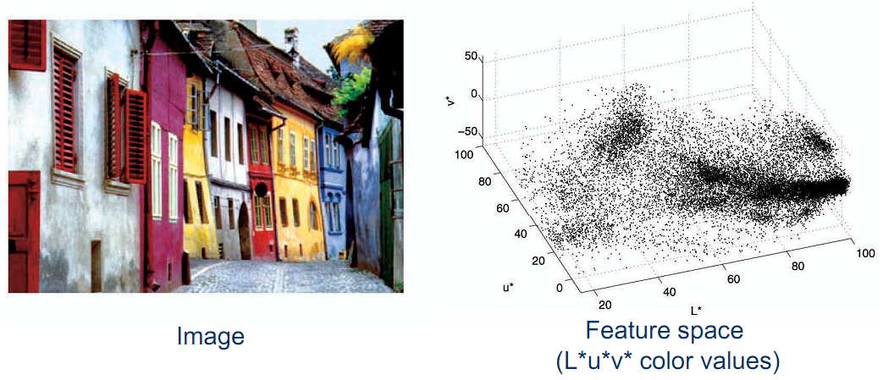
Mean Shift Algorithm
The mean shift algorithm seeks modes or local maxima of density in the feature space.
Non-parametric, iterative clustering method

Slide 19
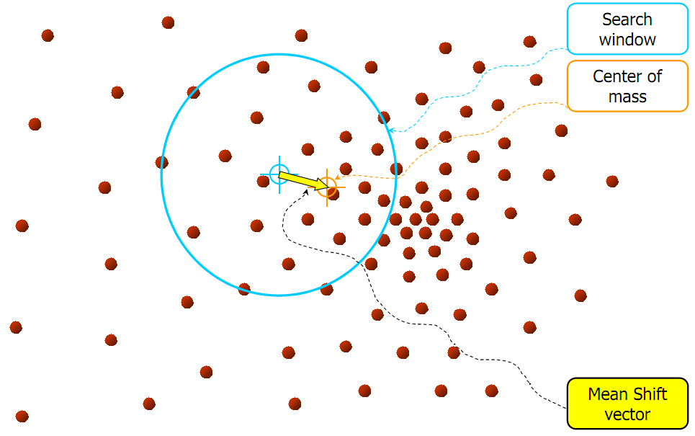
Mean Shift Algorithm
Non-parametric, iterative clustering method
Structure of the model is not fixed
Improves an initial guess by sequentially updating it
Seeks modes or local maximum (plural of maxima) within a window
Algorithm:
Starts from over sampled initial centroids
Repeat until convergence
Iteratively update centroids
Remove overlapping centroids if too close

Slide 20
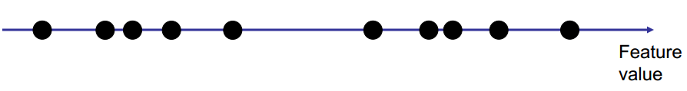
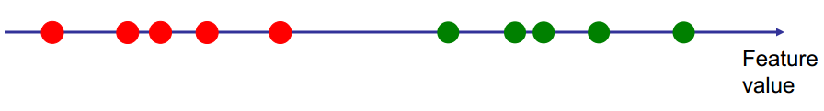
Mean Shift Algorithm
A 1-D Example

Slide 21
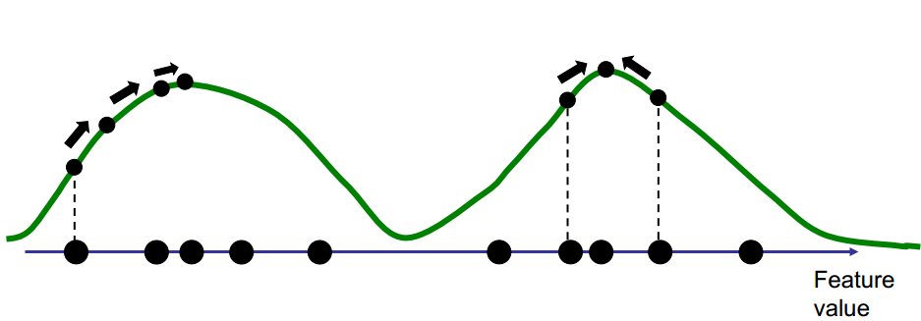
Mean Shift Algorithm

Slide 22
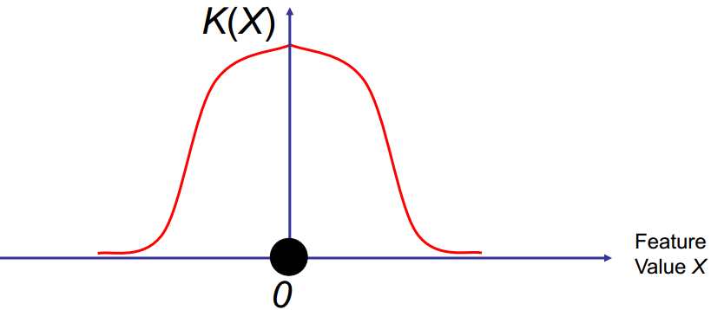
Mean Shift Algorithm
We define a kernel function: K(X), with the properties:
K decays to zero far from 0
K is maximum at 0
K is symmetric

Slide 23
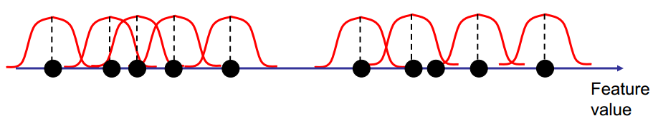
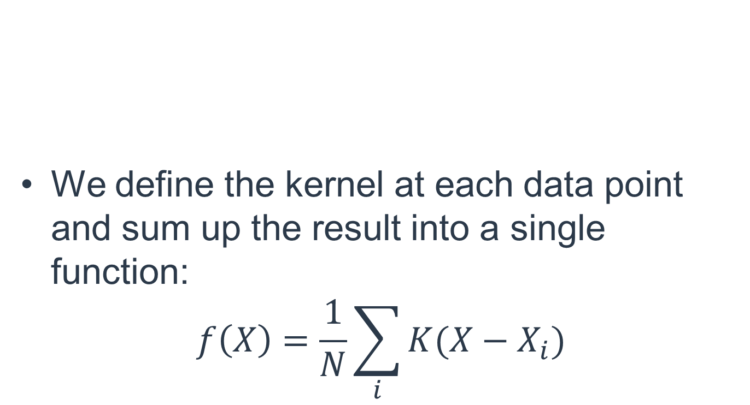
Mean Shift Algorithm
We define the kernel at each data point and sum up the result into a single function:
$$f\left(X\right)=\frac{1}{N}\sum_{i}{K(X−X_{i})}$$

Slide 24
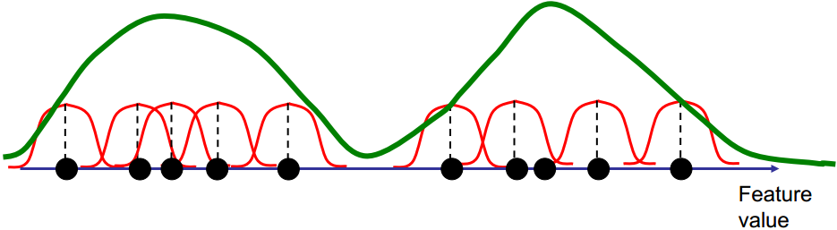
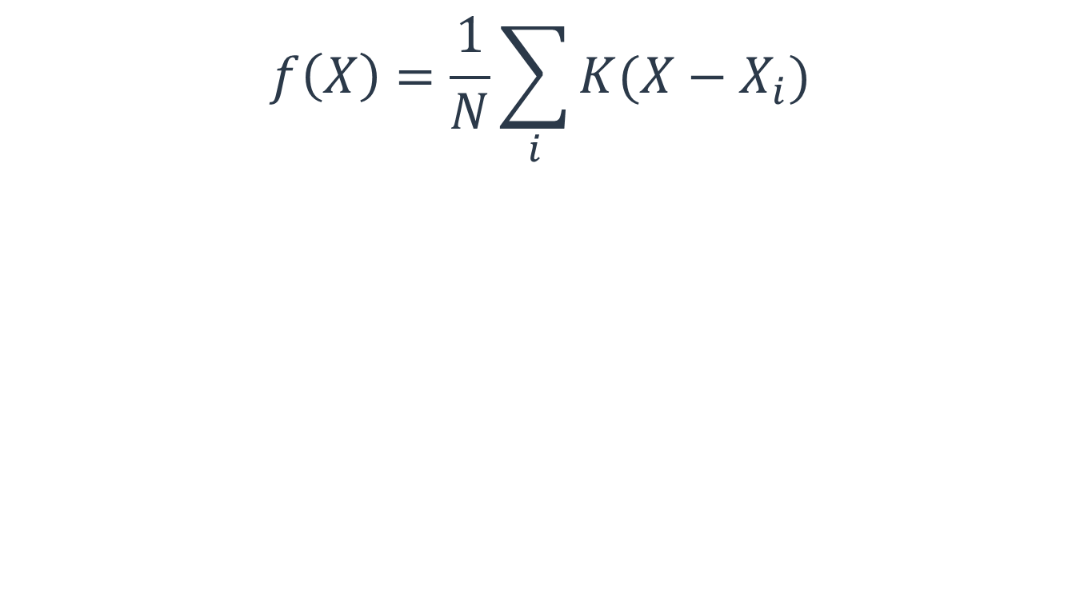
Mean Shift Algorithm
$$f\left(X\right)=\frac{1}{N}\sum_{i}{K(X−X_{i})}$$

Slide 25
Mean Shift Algorithm

Slide 26
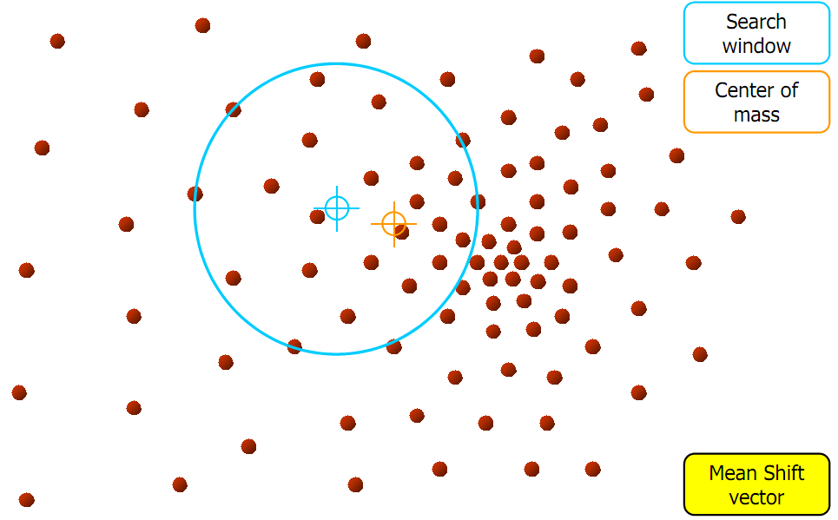
Mean Shift Algorithm

Slide 27
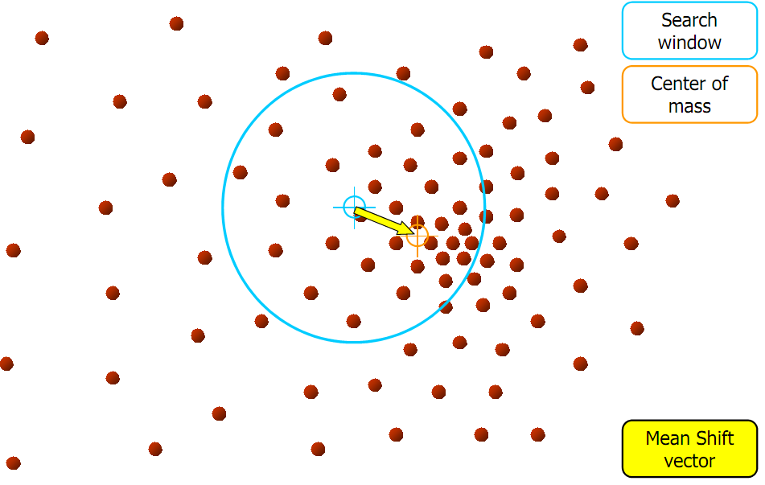
Mean Shift Algorithm

Slide 28
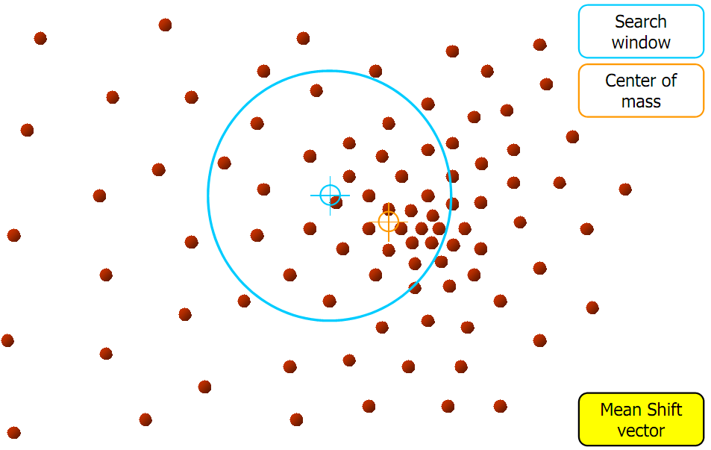
Mean Shift Algorithm

Slide 29
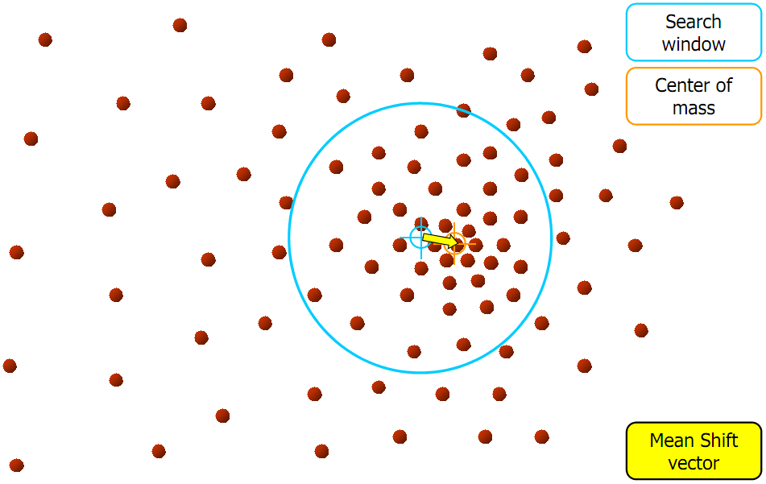
Mean Shift Algorithm

Slide 30
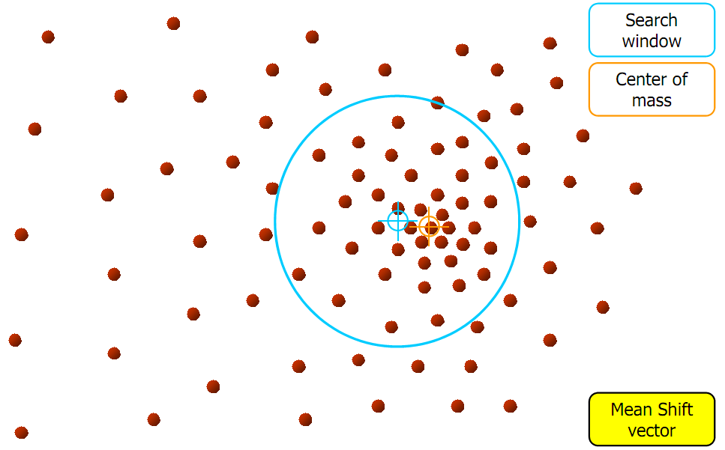
Mean Shift Algorithm

Slide 31
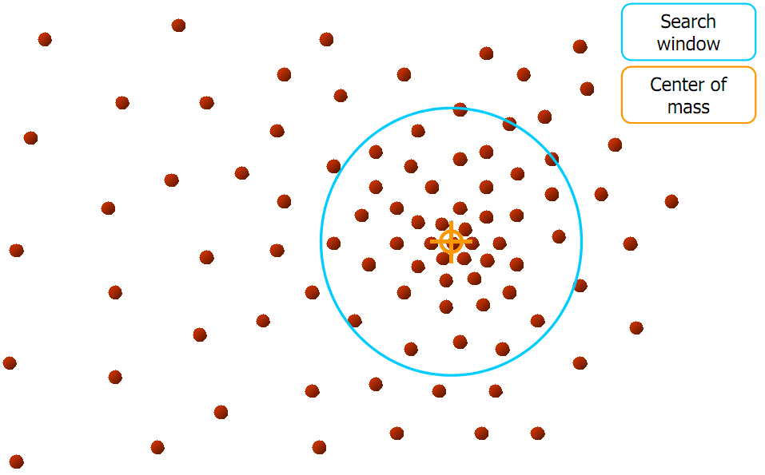
Mean Shift Algorithm

Slide 32
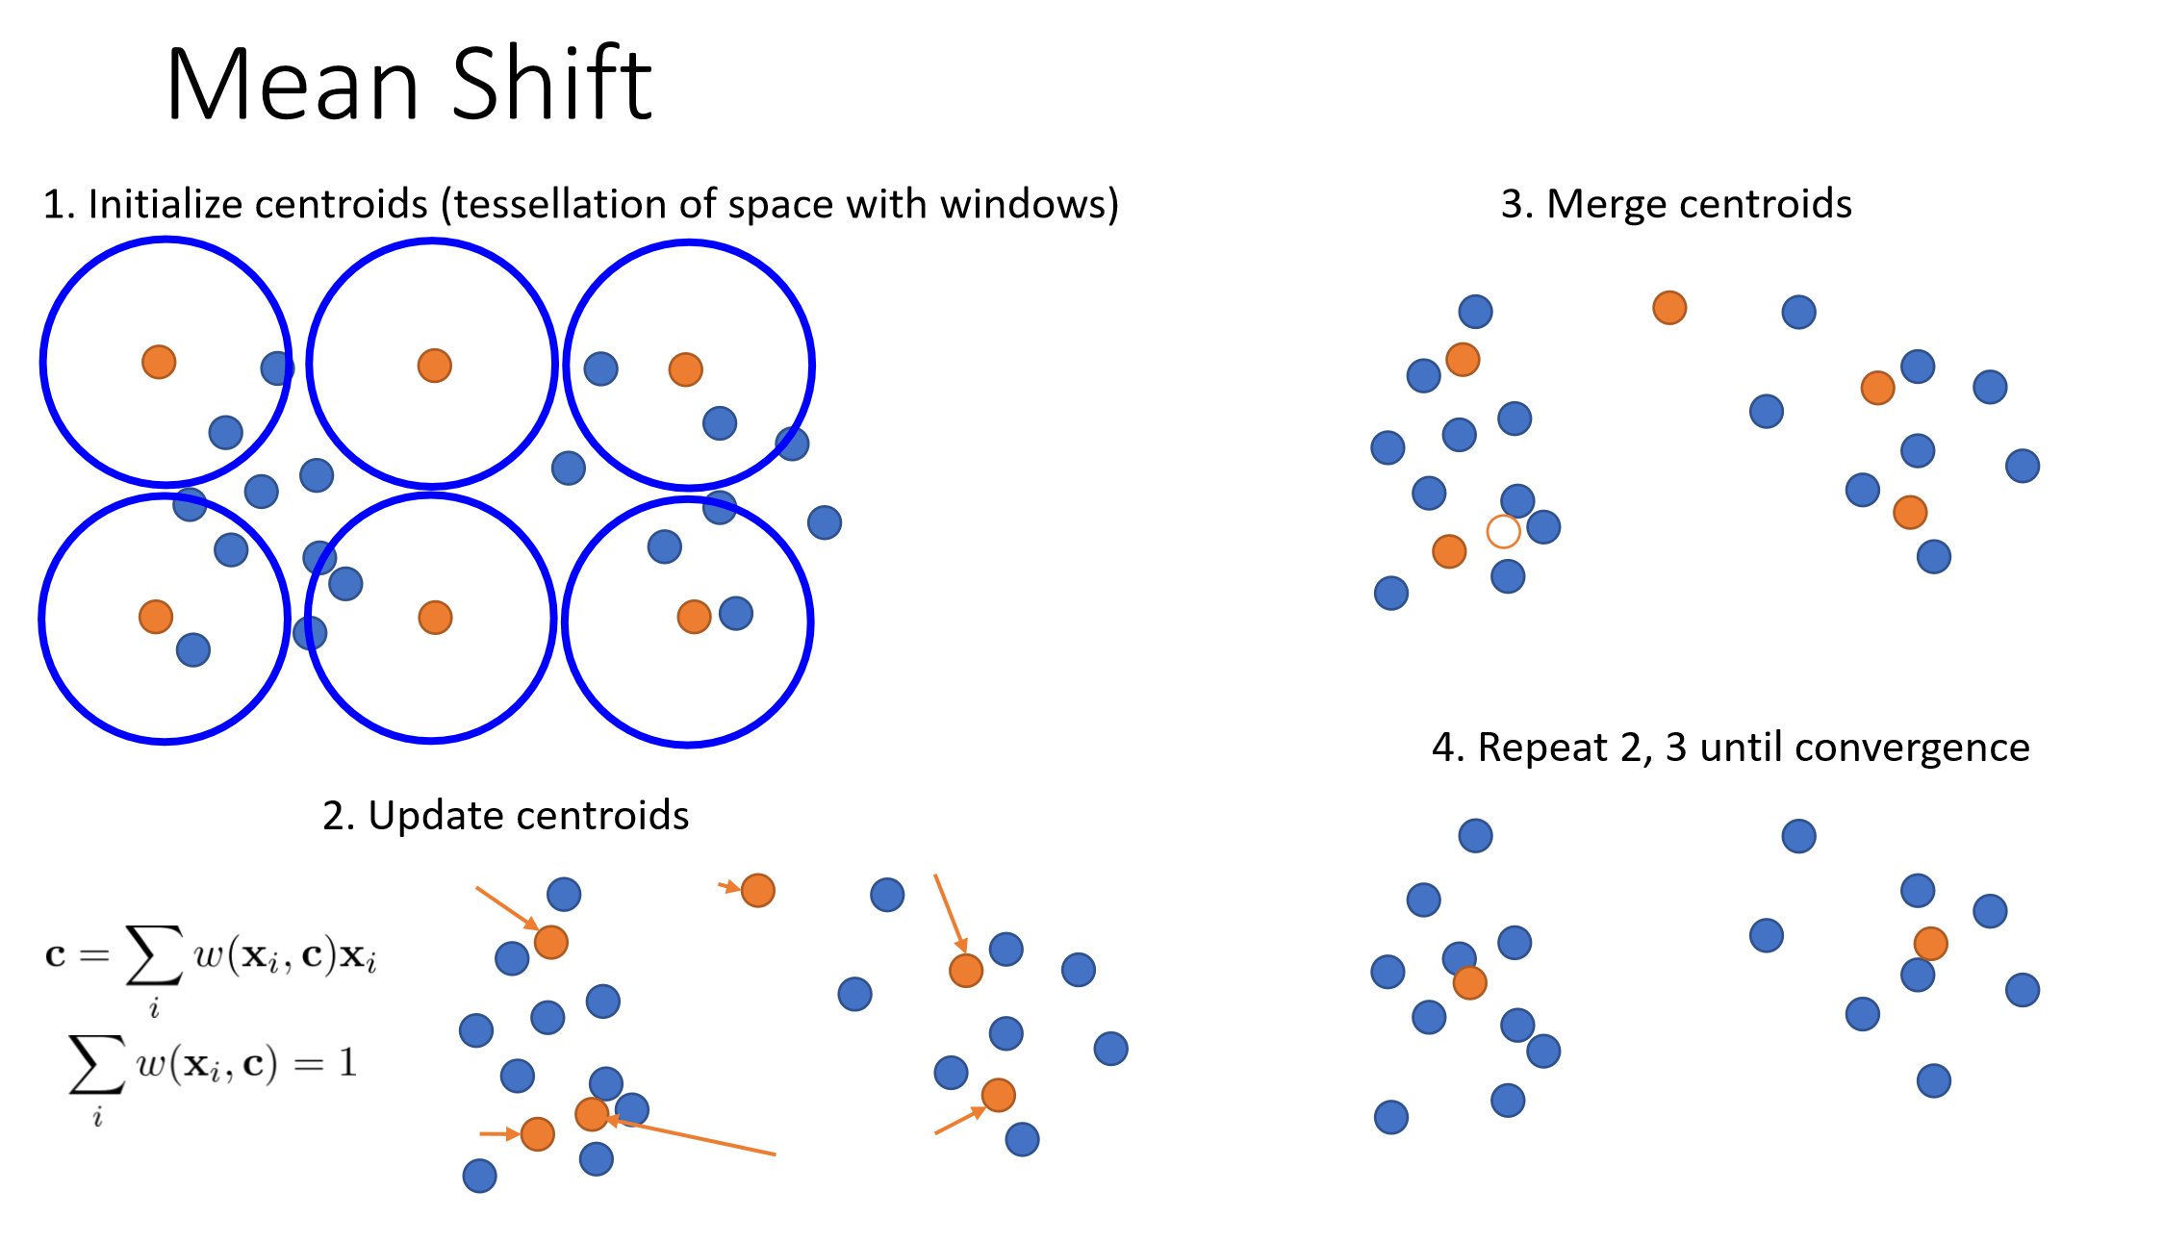

Slide 33
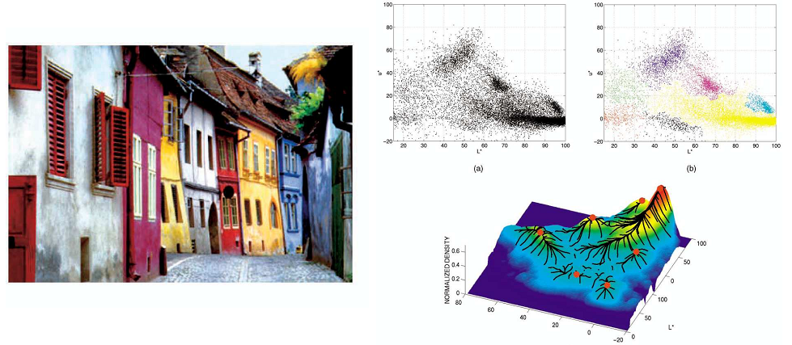
Mean Shift Clustering/Segmentation
Find features (color, gradients, texture, etc)
Initialize windows at individual feature points
Perform mean shift for each window until convergence
Merge windows that end up near the same “peak” or mode

Slide 34
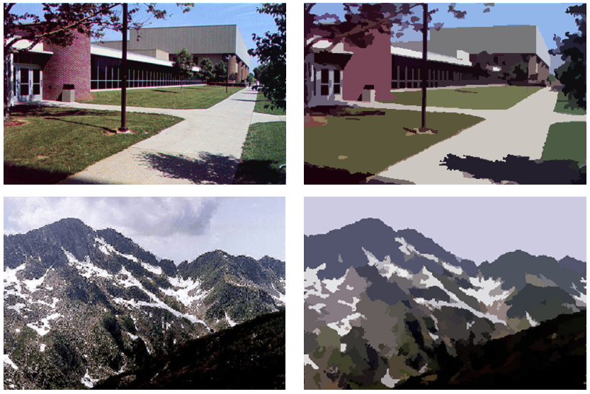
Mean Shift Segmentation
http://www.caip.rutgers.edu/~comanici/MSPAMI/msPamiResults.html

Slide 35
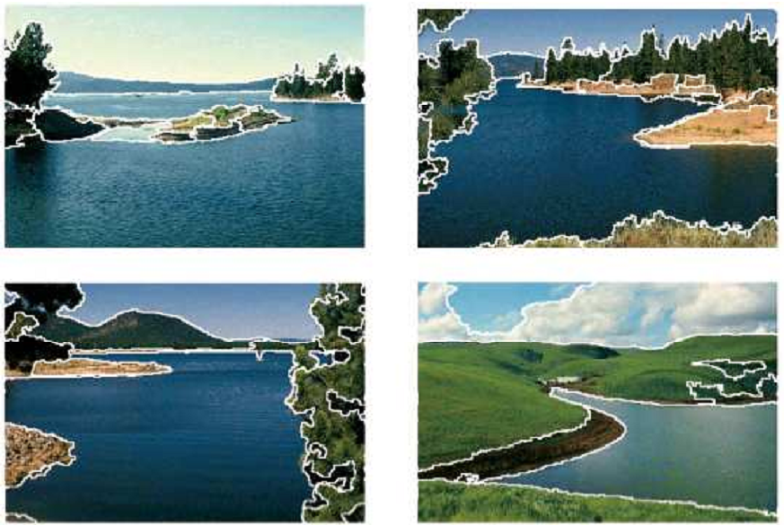
Mean Shift Segmentation

Slide 36
Mean Shift Segmentation
Pros:
Does not assume shape on clusters
One parameter choice (window size)
Generic technique
Find multiple modes
Cons:
Selection of window size
Does not scale well with dimension of feature space

Slide 37
Region Growing
Region growing techniques start with one pixel of a potential region and try to grow it by adding adjacent pixels till the pixels being compared are too dissimilar.
The first pixel selected can be just the first unlabeled pixel in the image or a set of seed pixels can be chosen (manually or automatically) from the image.
We need to define a measure of similarity between a pixel and a set of pixels as well as a rule that makes a decision for growing based on this measure.

Slide 38
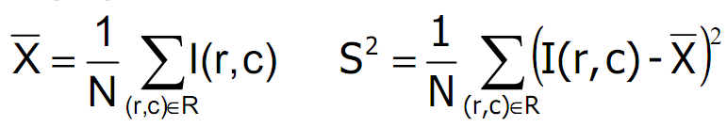
Region Growing
Usually a statistical test is used to decide which pixels can be added to a region.
Region is a population with similar statistics.
Use statistical test to see if neighbor on border fits into the region population.
Let R be the N pixel region so far and p be a neighboring pixel with gray tone y.
Define the mean X and scatter S² (sample variance) by

Slide 39
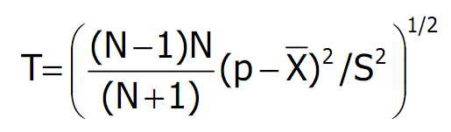
Region Growing
The T statistic is defined by
It has a T_{N-1} distribution if all the pixels in R and the test pixel p are independent and identically distributed Gaussians (i.i.d. assumption).

Slide 40
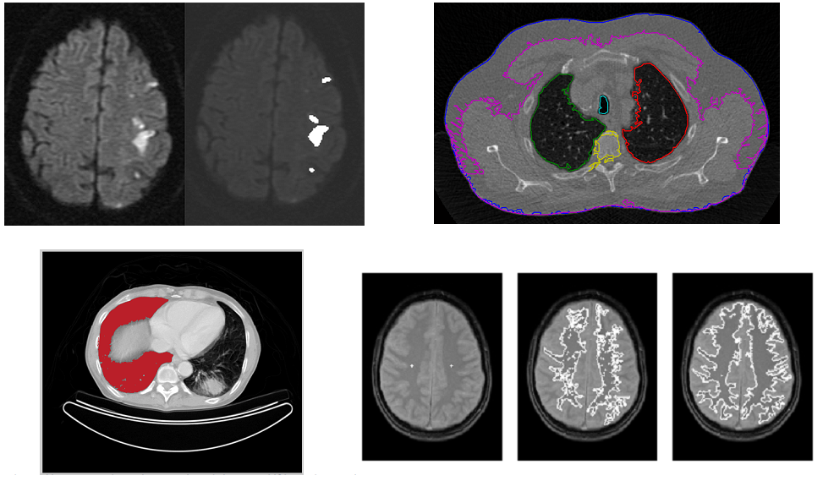
Region Growing

Slide 41
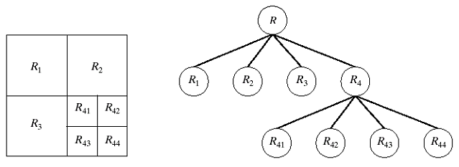
Split-and-merge
Start with the whole image（R）.
If the variance is too high, break into quadrants.
Merge any adjacent regions that are similar enough. P(Ri)=TRUE
Repeat steps 2 and 3, iteratively until no more splitting or merging occur.
Idea: good Results: blocky

Slide 42
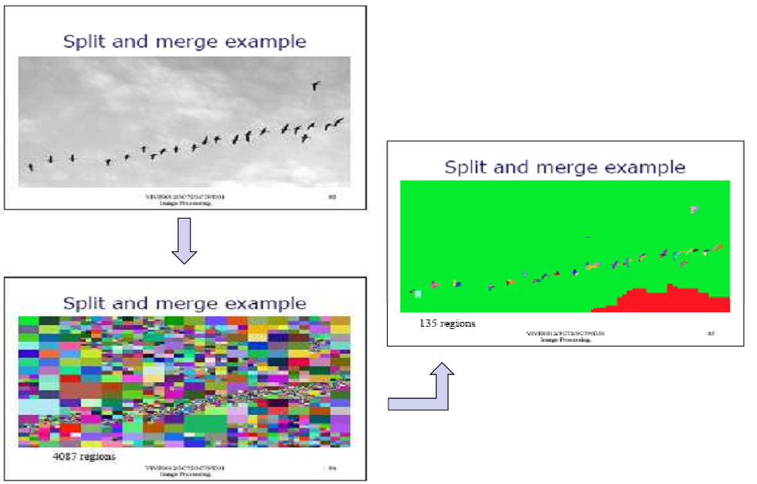
Split-and-merge

Slide 43
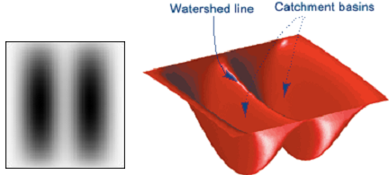
Watershed Segmentation
The image can be interpreted as a topographic surface, with both valleys and mountains.
Three types of points can be considered:
Points belonging to a regional minimum.
Points at which a drop of water, if placed at the location of any of those points, would fall to a single minimum.
→ catchment basins
Points at which water would be equally likely to fall to more than one such minimum. → watershed lines

Slide 44
Watershed Segmentation
Assume that there is a hole in each minima and the surface is immersed into a lake.
The water will enter through the holes at the minima and flood the surface.
To avoid the water coming from two different minima to meet, a dam is build whenever there would be a merge of the water.
Finally, the only thing visible of the surface would be the dams. These dam walls are called the watershed lines.

Slide 45
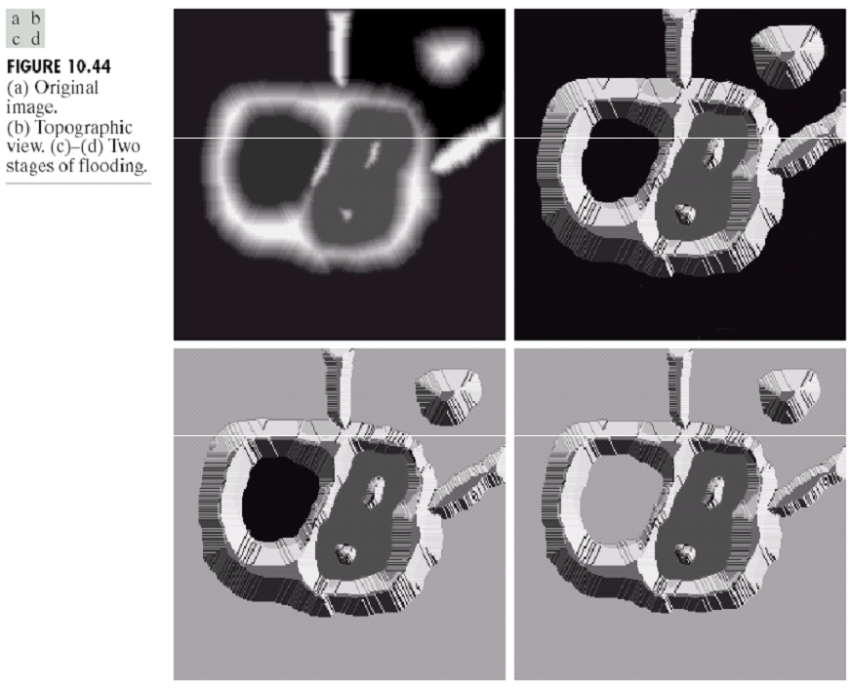
Watershed Segmentation

Slide 46
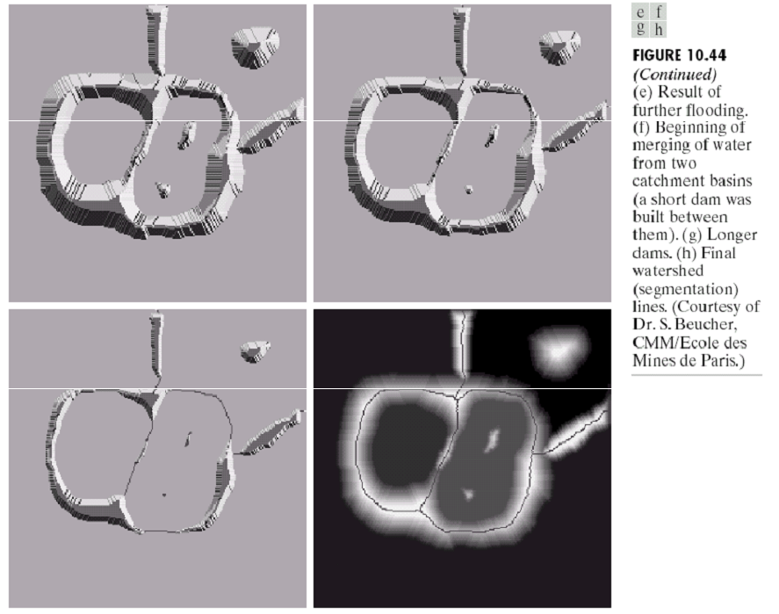
Watershed Segmentation

Slide 47
Watershed Segmentation
The key behind using the watershed transform for segmentation is this: change your image into another image whose catchment basins are the objects you want to identify.
Examples:
Distance transform can be used with binary images where the catchment basins correspond to the foreground components of interest.
Gradient can be used with grayscale images where the catchment basins should theoretically correspond to the homogeneous grey level regions of the image.

Slide 48
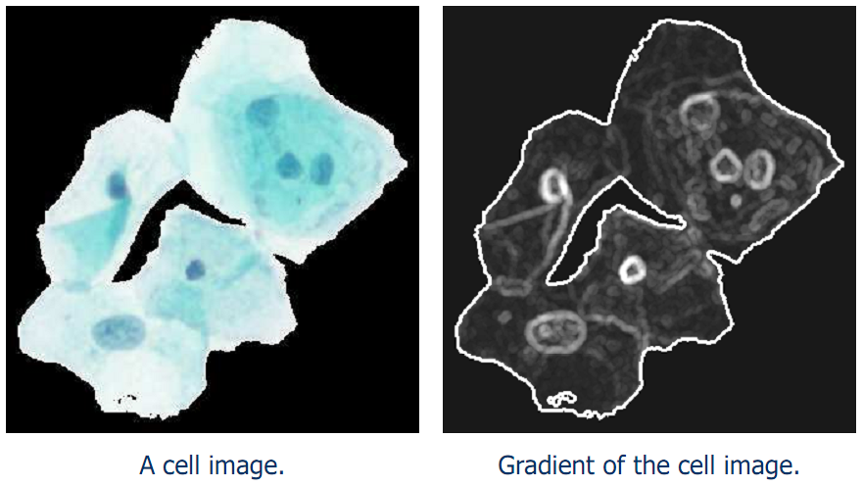
Watershed Segmentation

Slide 49
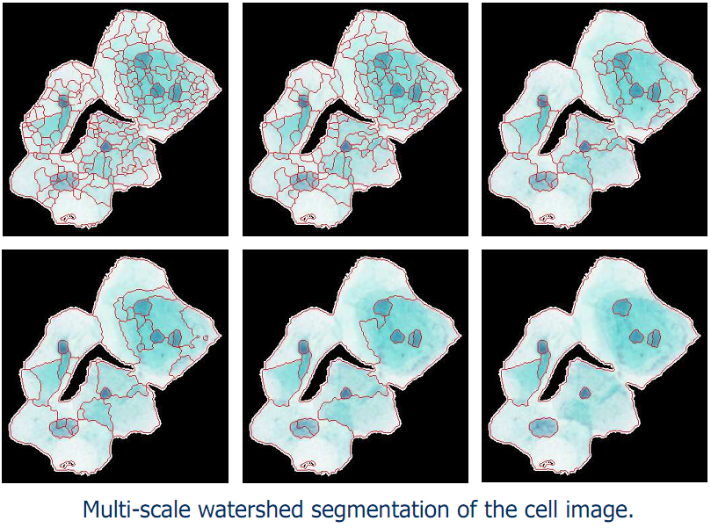
Watershed Segmentation

Slide 50
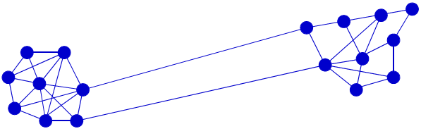
Graph-based Segmentation
An image is represented by a graph whose nodes are pixels or small groups of pixels.
The goal is to partition the nodes into disjoint sets so that the similarity within each set is high and across different sets is low.

Slide 51
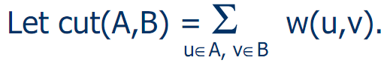
Graph-based Segmentation
Let G = (V,E) be a graph. Each edge (u,v) has a weight w(u,v) that represents the similarity between u and v.
Graph G can be broken into 2 disjoint graphs with node sets A and B by removing edges that connect these sets.

Slide 52
Graph-based Segmentation
Let G = (V,E) be a graph. Each edge (u,v) has a weight w(u,v) that represents the similarity between u and v.
Graph G can be broken into 2 disjoint graphs with node sets A and B by removing edges that connect these sets.
One way to segment G is to find the minimum cut.

Slide 53
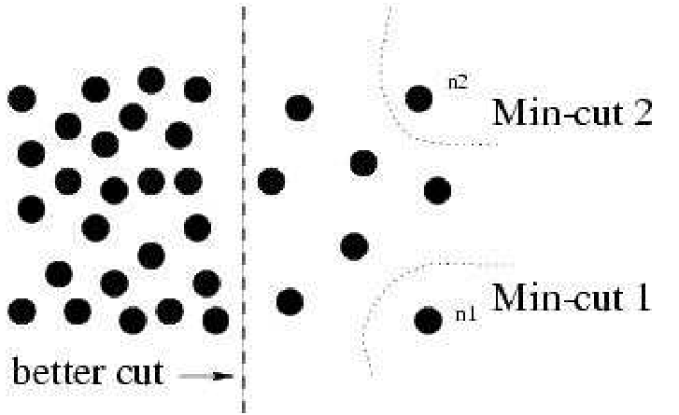
Graph-based Segmentation
Problem with minimum cut: weight of cut proportional to number of edges in the cut; tends to produce small, isolated components.

Slide 54
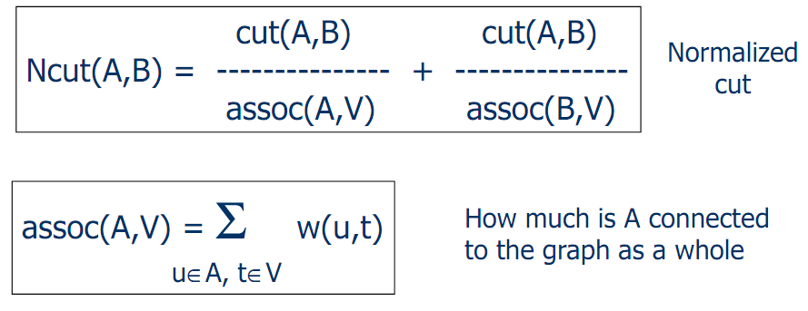
Graph-based Segmentation
Shi and Malik proposed the normalized cut.

Slide 55
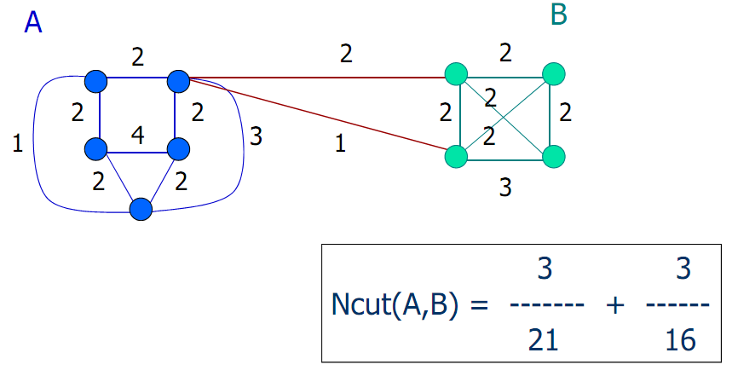
Graph-based Segmentation

Slide 56
Graph-based Segmentation
Shi and Malik turned graph cuts into an eigenvector/eigenvalue problem.
Set up a weighted graph G=(V,E).
V is the set of (N) pixels.
E is a set of weighted edges (weight w_{ij} gives the similarity between nodes i and j).
Length N vector d: d_{i} is the sum of the weights from node i to all other nodes.
N x N matrix D: D is a diagonal matrix with d on its diagonal.
N x N symmetric matrix W: W_{ij}= w_{ij}.

Slide 57
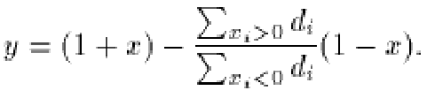
Graph-based Segmentation
Let x be a characteristic vector of a set A of nodes.
X_{i} = 1 if node i is in a set A
x_{i} = -1 otherwise
Let y be a continuous approximation to x.
Solve the system of equations
(D – W) y = λ D y
for the eigenvectors y and eigenvalues λ.
Use the eigenvector y with second smallest eigenvalue to bipartition the graph (y → x → A).
If further subdivision is merited, repeat recursively.

Slide 58
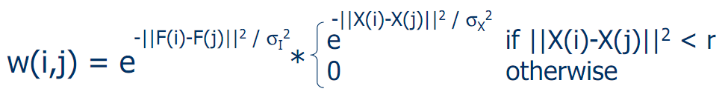
Graph-based Segmentation
Edge weights w(i,j) can be defined by
where
X(i) is the spatial location of node I
F(i) is the feature vector for node I which can be intensity, color, texture, motion…
The formula is set up so that w(i,j) is 0 for nodes that are too far apart.

Slide 59
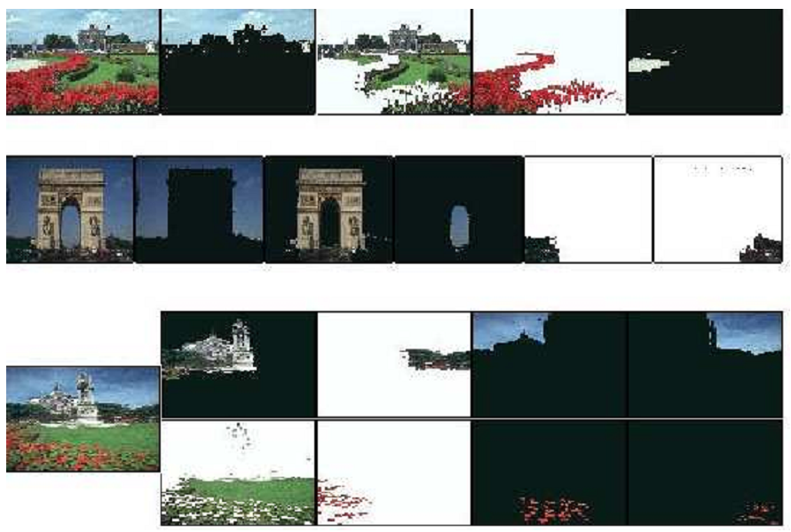
Graph-based Segmentation

Slide 60
Graph-based Segmentation
Pros:
Generic framework, flexible to choice of function that computes weights (“affinities”) between nodes
Does not require model of the data distribution
Cons:
Time complexity can be high
Dense, highly connected graphs → many affinity computations
Solving eigenvalue problem

